Slide 1
Protection Identification of Corrupted data security
Project Team: Kent Michael Miculob Maria Letty Laureta Reginald John Steven Alberca

Slide 2
Project Context
The risk of Data corruption
Data Corruption threats in IOT implementation

Slide 3
Purpose and Description
Advancement of technology
Evolution of security issues
Huge consequences are at risk.
Minimizing the effect of data corruption

Slide 4
Objective
General Objectives:
This Project aims to create a forensic tool capable of protecting someone information from data loss.
Specific Objectives:
To be able to create a forensic tool capable of preventing and detecting text file data corruption.
To be able to provide a portable forensic tool.
To be able to produce a seamless data corruption prevention and detection tool.

Slide 5
Scope and Limitations
Students and office workers
Windows based OS-7 and higher
Focus on all-text file
NTFS File architecture
Data corruption prevention and detection
Interactions are limited on players of the system
Minimum of 4g flash drive
The memory space should be less than 90% to achieve maximum performance.

Slide 6
Related Literature
Causes of Data Corruption
Checksum
File System
RAID Technology
Assembly Language
An Analysis of Data Corruption in the Storage Stack

Slide 7
Technical Background
How DirSyncPro works
Creating jobset
Specifying source and destination directories.
Synchronization choice

Slide 8
Design and Methodology
The system will automatically scan for corrupted data.
If there’s a corrupted file the system itself will identify whether it is fixable or not
If the found corrupted file is identify fixable then the system will prompt the admin to fix the corruption.
Then it will automatically scan for the memory space of the flash drive.
Every time the admin will open an instance of text file the system would create a real-time back up.
Each change made or each execution are recoded in a log which can be view or downloaded by the admin.

Slide 9
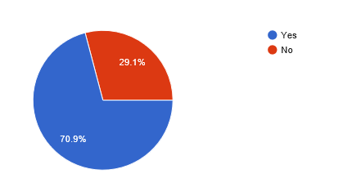
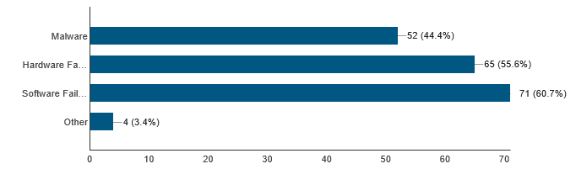
Survey Result.
Percentage of people Experienced data corruption.
Frequency of the causes.

Slide 10
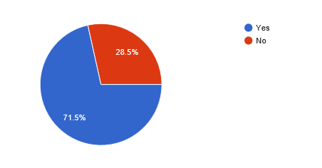
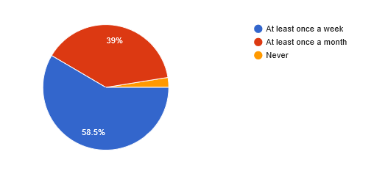
Percentage of population of who does back up.
How often they do back up

Slide 11
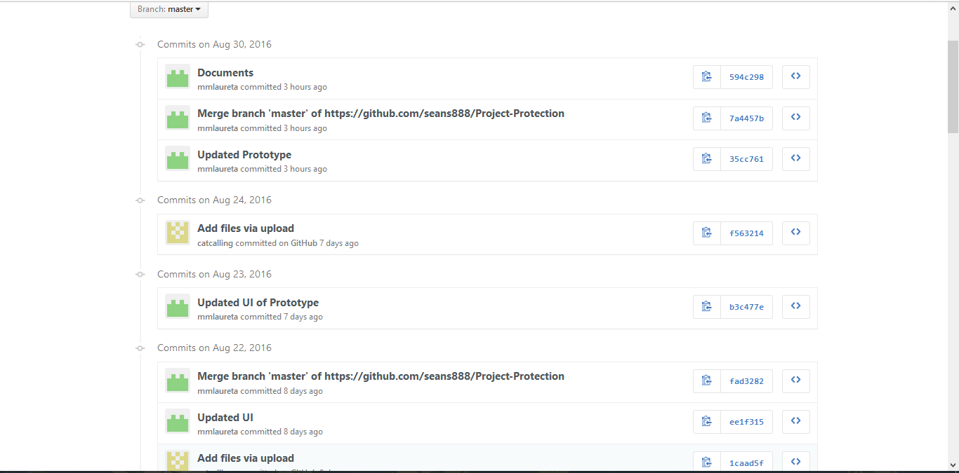
SCREENSHOT OF GITHUB COMMITS

Slide 12
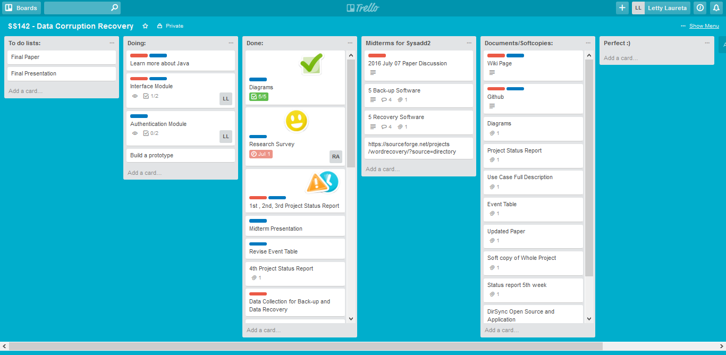
SCREENSHOT OF TRELLO

Slide 13
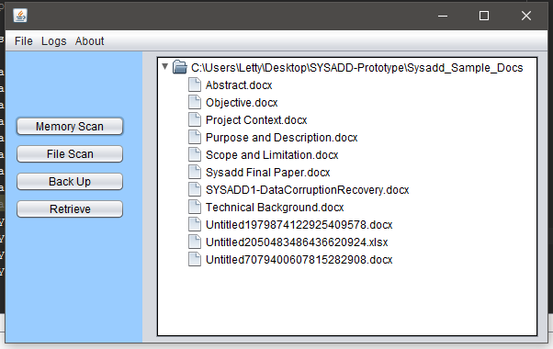
SCREENSHOTS OF PROTOTYPE
Initial Frame

Slide 14
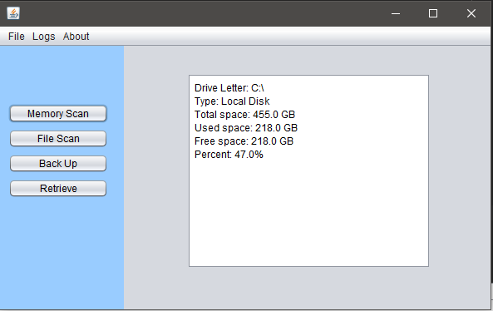
SCREENSHOTS OF PROTOTYPE
Memory Scan Frame

Slide 15
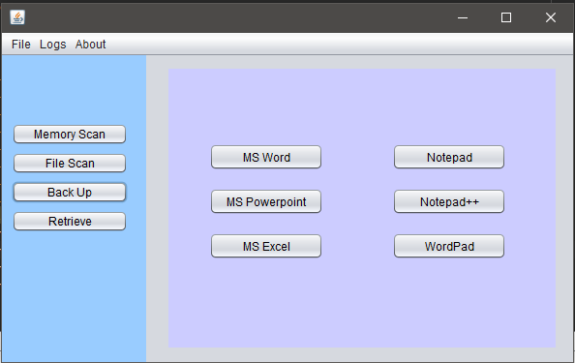
SCREENSHOTS OF PROTOTYPE
Back-Up Frame

